Slide 1
Chapter 6: Process Synchronization
Apr, 2021

Slide 2
Chapter 6: Process Synchro
Synchronization Hardware
Mutex Locks
Semaphore
Process Synchronization Problems

Slide 3
Objectives
To present hardware solutions of the critical-section problem
To explore several tools that are used to solve process synchronization problems
To examine several classical process-synchronization problems

Slide 4
Review
Race condition
Critical section
Mutual exclusion
Progress
Bounded waiting
Software solution

Slide 5
Synchronization Hardware
Many systems provide hardware support for critical section code
Uniprocessors – could disable interrupts
Currently running code would execute without preemption
Multiprocessors?
lock

Slide 6
Mutex Locks
Previous solutions are complicated and generally inaccessible to application programmers
OS designers build software tools to solve critical section problem
Simplest is mutex lock (mutual exclusion lock)
first acquire() a lock
then release() it
Boolean variable indicating if lock is available or not

Slide 7
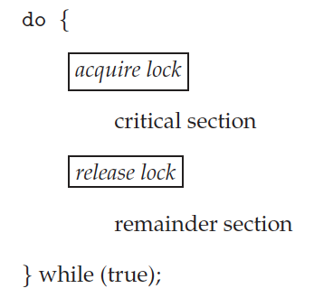


Solution to Critical-section Problem Using Locks
test_and_set
compare_and_swap

Slide 8
Demo
counter++

Slide 9
Mutex Locks
Calls to acquire() and release() must be atomic
Usually implemented via hardware atomic instructions
But this solution requires busy waiting
This lock therefore called a spinlock

Slide 10
Limitations of Spinlock
Busy waiting
Wait queue

Slide 11
Concurrency
Competition
Cooperation
race condition
critical section
mutual exclusion
synchronization

Slide 12
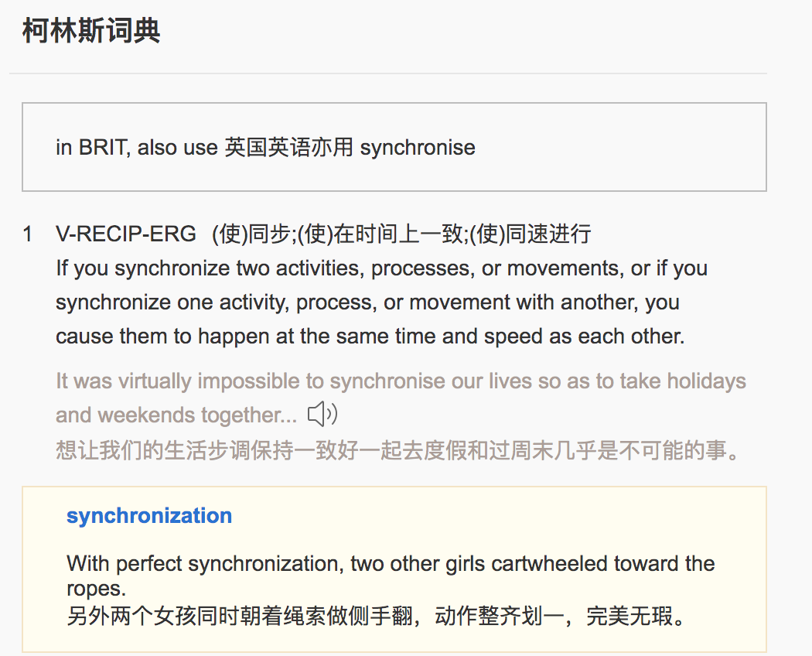
Synchronization

Slide 13
Demo
Process A
print(“A”)
Process B
print(“B”)
A and B run concurrently

Slide 14
Synchronize A with B
A
B
A
B
A
…
How to?

Slide 15
AB
print “A”
print “B”
print “A”
print “B”
print “A”

Slide 16
Demo
Process A
print(“A”)
Process B
print(“B”)
Process C
print(“C”)
A and B and C run concurrently

Slide 17
Synchronize A with B and C
A
B (C)
C (B)
A
B (C)
C (B)
…
How to?

Slide 18
ABC
print “A”
print “C”
print “B”
print “A”
print “C”
print “B”
print “A”

Slide 19
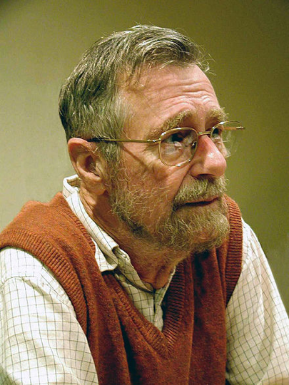
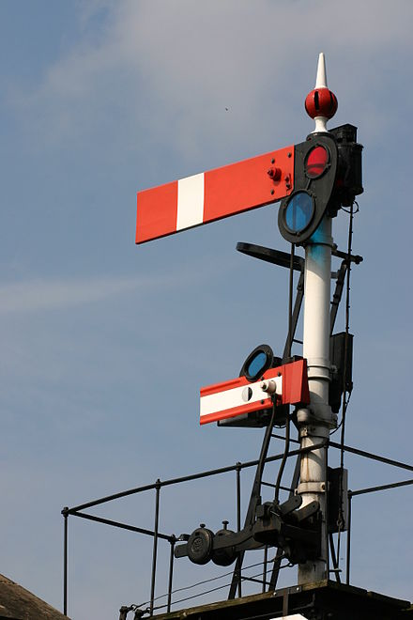
Semaphore
Dijkstra

Slide 20


Mutex Lock

Slide 21
Mutex Lock
Room_A
Room_B
Acquire（）
Release（）
Key_A
Key_B

Slide 22
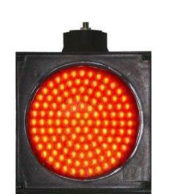
Semaphore
X

Slide 23
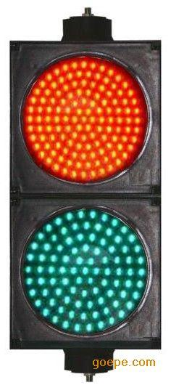
Semaphore
Room_A
Room_B
X
X

Slide 24
Semaphore
Semaphore S – integer variable
Two standard operations modify S:
wait() and signal()
Originally called P() and V()
Proberen: test
Verhogen: increment
Notes:
proberen: 检测
verhogen: 增量

Slide 25
Implementation of Semaphore
wait(S)
{
while(S <= 0); // busy wait
S--;
}
signal(S)
{
S++;
}
Problem??
Notes:
proberen: 检测
verhogen: 增量
Problem: busy wait and critical section

Slide 26
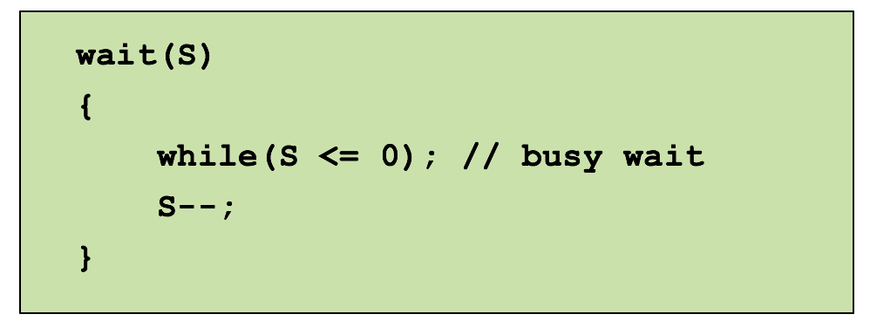
Semaphore with busy waiting

Slide 27
Semaphore with no Busy Waiting
typedef struct
{
int value;
struct process *list;
} semaphore;

Slide 28
Semaphore with no Busy Waiting
wait(semaphore *S)
{
S->value--;
if(S->value 0)
{ add this process to S->list;
block();
}
}
<

Slide 29
Semaphore with no Busy Waiting
signal(semaphore *S)
{
S->value++;
if(S->value 0)
{ remove a process P from S->list;
wakeup(P);
}
}
<=

Slide 30
Semaphore with no Busy Waiting
With each semaphore there is an associated waiting queue
Each entry in a waiting queue has two data items:
value (of type integer)
pointer to next record in the list
Two operations:
block – place the process invoking the operation on the appropriate waiting queue
wakeup – remove one of processes in the waiting queue and place it in the ready queue

Slide 31
Semaphore Implementation
Must guarantee that no two processes can execute wait() and signal() on the same semaphore at the same time
Thus, implementation becomes the critical section problem where the wait and signal code are placed in the critical section
wait(semaphore *S)
{
S->value--;
if(S->value < 0)
{ add this process to S->list;
block();
}
}
atomic

Slide 32
Semaphore Implementation
Must guarantee that no two processes can execute wait() and signal() on the same semaphore at the same time
Thus, implementation becomes the critical section problem where the wait and signal code are placed in the critical section
Hardware instruction
signal(semaphore *S)
{
S->value++;
if(S->value <= 0)
{ remove a process P from S->list;
wakeup(P);
}
}
atomic
Mutex lock
Semaphore

Slide 33
Demo of AB
A
B
A
B
…

Slide 34
Demo of ABC
A
B
C
A
C
B
A
B
C
…

Slide 35
Semaphore Type
Binary semaphore
Integer value can range only between 0 and 1
Then a mutex lock for mutual exclusion
Must be initialized to 1
Room_A
Room_B
X
X
X

Slide 36

Semaphore Type
Binary semaphore
Integer value can range only between 0 and 1
Then a mutex lock for mutual exclusion
Must be initialized to 1
Counting semaphore
Integer value can range over an unrestricted domain

Slide 37
Mutex Lock vs. Semaphore
Scenarios
Contention: critical section
Cooperation: synchronization, resources
Operations
acquire/release (release->acquire??)
wait/signal, P/V
Same or different processes
Initialization
unlocked (two values, locked or unlocked)
0,1,2,…,n
Implementation
Hardware instruction
Wait queue (spinlock, busy waiting)
Binary semaphore used as mutex lock
Initialized to 1

Slide 38
Synchronization Problems

Slide 39
Classical Problems of Synchronization
Classical problems used to test newly-proposed synchronization schemes
Producer-Consumer Problem
Readers and Writers Problem
Dining-Philosophers Problem

Slide 40
The Use of Synchronization Tools
What problem
Identify shared resources, race condition, and critical section
Identify number of resources
Identify synchronization points
Which tool
Mutex lock, semaphore, and others
Busy waiting or suspending
Duration of critical section
Context switch cost
How to initialization
Number of resources
Binary semaphore
Mutex lock

Slide 41
Circular Buffer
https://en.wikipedia.org/wiki/Circular_buffer

Slide 42
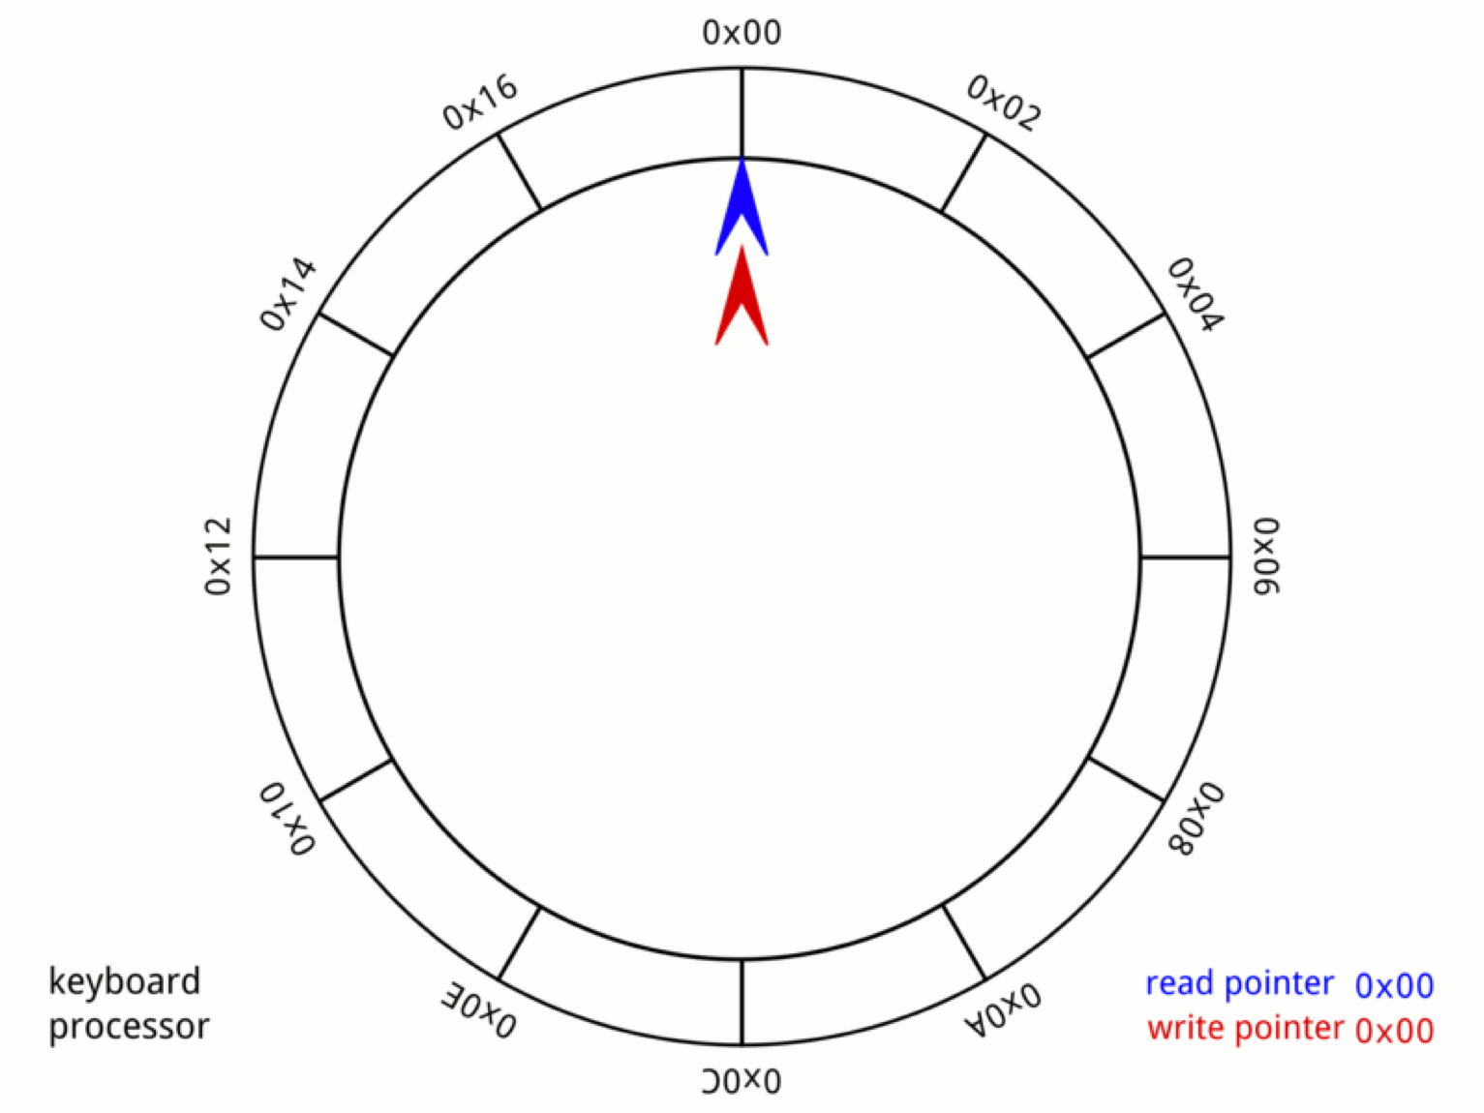
Identify Race Condition and Cooperation
https://en.wikipedia.org/wiki/Circular_buffer
Notes:
Difficulty: multiple producer and consumer

Slide 43
Producer-Consumer Problem (1)
count = 0;
producer
consumer
while(true)
{ while(count == BUFFER_SIZE);
count++;
}
while(true)
{
while(count == 0);
count--;
}
Problem?
Notes:
Critical section, race condition

Slide 44
Producer-Consumer Problem (2)
count = 0;
lock = 1;
producer
consumer
while(true)
{ while(count == BUFFER_SIZE);
wait(lock);
count++;
signal(lock);
}
while(true)
{
while(count == 0);
wait(lock);
count--;
signal(lock);
}
Problem?
Notes:
Busy waiting

Slide 45
Producer-Consumer Problem (3)
count = 0;
lock = 1;
producer
consumer
while(true)
{ if(count == BUFFER_SIZE)
sleep();
wait(lock);
count++;
signal(lock);
if(count == 1)
wakeup(consumer);
}
while(true)
{
if(count == 0)
sleep();
wait(lock);
count--;
signal(lock);
if(count == BUFFER_SIZE-1)
wakeup(producer);
}
Problem?
Notes:
Multiple producer or consumer: eg. 1 producer, 2 consumers
Problem: lost signal / empty test fail

Slide 46
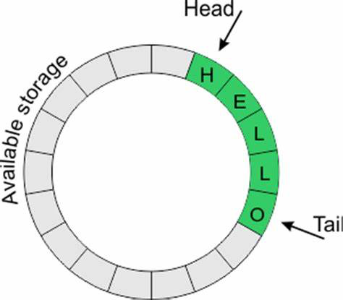
Producer-Consumer Problem ()
n buffers, each can hold one item
Semaphore lock initialized to the value 1
Semaphore full initialized to the value 0
Semaphore empty initialized to the value n
producer
consumer
do{
wait(empty);
wait(lock);
count++;
signal(lock);
signal(full);
}while(true);
do{
wait(full);
wait(lock);
count--;
signal(lock);
signal(empty);
}while(true);

Slide 47

Web Database

Slide 48
Readers-Writers Problem
A data set is shared among a number of concurrent processes
Readers – only read the data set; do not perform any updates
Writers – can both read and write
Requirements
allow multiple readers to read at the same time
only one single writer can access shared data at the same time
if a writer is writing to the file, no reader may read it
Several variations of how readers and writers are treated

Slide 49
Readers-Writers Problem Variations
First variation
no reader should wait for other readers to finish simply because a writer is waiting
readers have priority
Second variation
if a writer is waiting to access the object, no new readers may start reading
writers have priority

Slide 50
Difference between P-C & R-W
Readers do not modify shared data
Readers do not compete with each other
Readers and Writers do not need to test FULL or EMPTY

Slide 51
Identify Race Condition (1)
Shared Data
lock = 1;
reader
writer
do{
wait(lock);
read();
signal(lock);
}while(true);
do{
wait(lock);
write();
signal(lock);
}while(true);
Problem?
Notes:
New readers need to wait

Slide 52
First R-W: Add Reader Count
reader
lock = 1;
writer
do{
if(reader_count == 0)
wait(lock);
reader_count++;
read();
reader_count--;
if(reader_count == 0)
signal(lock);
}while(true);
do{
wait(lock);
write();
signal(lock);
}while(true);
Problem?

Slide 53
Identify Race Condition (2)
reader
lock = 1;
writer
do{
if(reader_count == 0)
wait(lock);
reader_count++;
read();
reader_count--;
if(reader_count == 0)
signal(lock);
}while(true);
do{
wait(lock);
write();
signal(lock);
}while(true);
Notes:
Race condition

Slide 54
First Readers-Writers Problem
Semaphore rw_lock initialized to 1
Integer reader_count initialized to 0
Semaphore rc_lock initialized to 1
reader
do{
wait(rc_lock);
if(reader_count == 0)
wait(rw_lock);
reader_count++;
signal(rc_lock);
read();
wait(rc_lock);
reader_count--;
if(reader_count == 0)
signal(rw_lock);
signal(rc_lock);
}while(true);
do{
wait(rw_lock);
write();
signal(rw_lock);
}while(true);
Writer

Slide 55
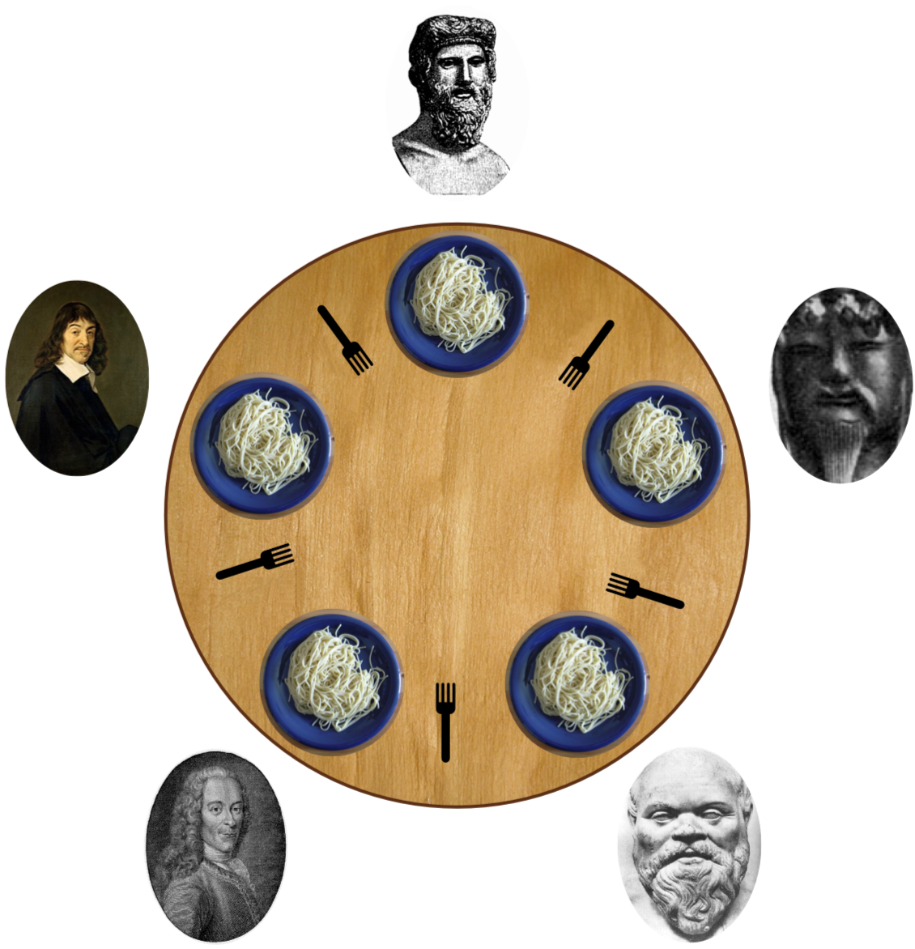
Dining-Philosophers Problem
https://en.wikipedia.org/wiki/Dining_philosophers_problem

Slide 56
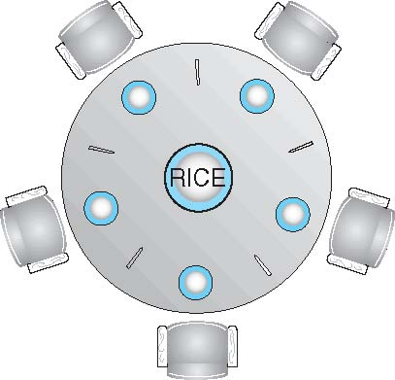
Dining-Philosophers Problem
Philosophers spend their lives thinking and eating
Don’t interact with their neighbors, occasionally try to pick up 2 chopsticks, one at a time, to eat from bowl
Need both to eat, then release both when done
Pick up the two chopsticks that are closest to her/him
She/he cannot pick up a chopstick that is already in the hand of a neighbor

Slide 57
Identify Mutual Exclusion
Shared data
Semaphore chopstick [5] initialized to 1

Slide 58
Dining-Philosophers Problem Algorithm
The structure of Philosopher i
do {
wait ( chopstick[i] );
wait ( chopstick[(i + 1) % 5] );
// eat
signal ( chopstick[i] );
signal ( chopstick[(i + 1) % 5] );
// think
} while (TRUE);
What is the problem with this algorithm?
Demo

Slide 59
Possible Remedies
Allow at most four philosophers to be sitting simultaneously at the table.
No deadlock
Allow a philosopher to pick up her chopsticks only if both chopsticks are available (to do this, she must pick them up in a critical section).
No deadlock
Use an asymmetric solution—that is, an odd-numbered philosopher picks up first her left chopstick and then her right chopstick, whereas an even numbered philosopher picks up her right chopstick and then her left chopstick.
No deadlock

Slide 60
A Possible Remedy
The structure of Philosopher i
do {
acquire(lock);
wait ( chopstick[i] );
wait ( chopstick[(i + 1) % 5] );
// eat
signal ( chopstick[i] );
signal ( chopstick[(i + 1) % 5] );
release(lock);
} while (TRUE);
What is the problem with this algorithm?
Notes:
Critical section too long

Slide 61
A Possible Remedy
The structure of Philosopher i
do {
acquire(lock);
wait ( chopstick[i] );
wait ( chopstick[(i + 1) % 5] );
release(lock);
// eat
signal ( chopstick[i] );
signal ( chopstick[(i + 1) % 5] );
} while (TRUE);
What is the problem with this algorithm?
Notes:
Do not release lock

Slide 62
The End

Slide 63
Liveness
Liveness refers to a set of properties that a system must satisfy to ensure that processes make progress during their execution life cycle.
Deadlock: A situation in which two or more processes are unable to proceed because each is waiting for one of the others to do something.
Livelock: A situation in which two or more processes continuously change their states in response to changes in the other process(es) without doing any useful work
Starvation: A situation in which a runnable process is overlooked indefinitely by the scheduler; although it is able to proceed, it is never chosen.

Slide 64
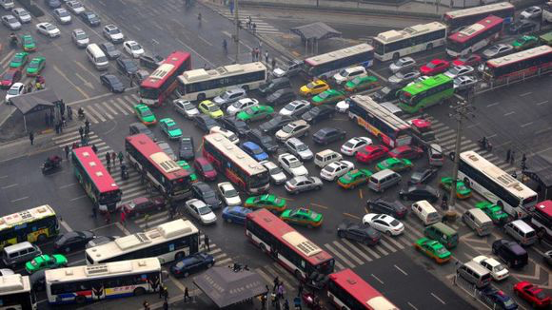
Deadlock

Slide 65
Livelock

Slide 66
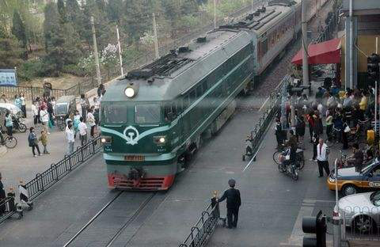
Starvation

Slide 67
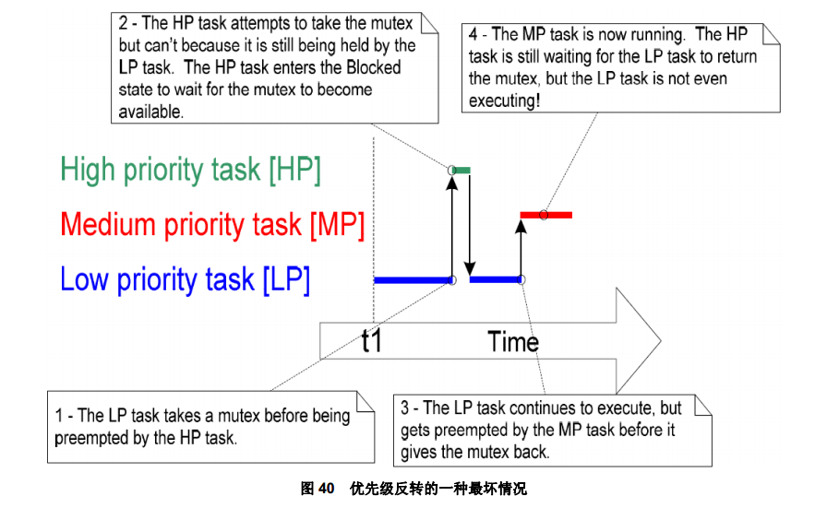
Priority Inversion

Slide 68


Example
Priority inheritance

